Slide 1
ORGANIZING or STRUCTURING
Addendum for MGT3110

Slide 2
Organizing
0
Organizing follows from strategy
(Structure follows Strategy)
Strategy dictates what you do
Organization dictates how you do it
Organizing is the deployment of organizational resources to achieve strategic goals in an effective and efficient manner (money, people)

Slide 3
Organizing The Structure
0
The set of formal tasks assigned to departments and individuals
Formal reporting relationships, including lines of authority, decision responsibility, number of levels and span of management
The design of systems to ensure effective coordination of employees across departments

Slide 4
Organizing Concepts
0
Work Specialization – the division tasks into individual jobs called division of labor
Chain of Command – a line of authority that links individuals and direct reports
Scalar Chain – each person has only one boss

Slide 5
Authority, Responsibility, and Delegation
0
The chain of command illustrates authority
Authority is the formal right to make decisions and issues orders
Authority is vested in organizational positions, not people
Authority is accepted by subordinates
Authority flows down the vertical hierarchy
Responsibility is the duty to perform the task or activity assigned
Delegation is what managers use to transfer authority and responsibility to others

Slide 6
Proper Delegation
Select the right person
Train that person
Give authority that is equivalent to the responsibility
Assign the whole task
Regular follow up

Slide 7
Line and Staff Authority
0
Line departments perform the tasks that reflect the organization’s primary goals
They work directly with customers/products
Value Added (Value Stream)
Staff departments are those departments that provide specialized skills in support of line departments
Legal, Human Resources, Marketing

Slide 8
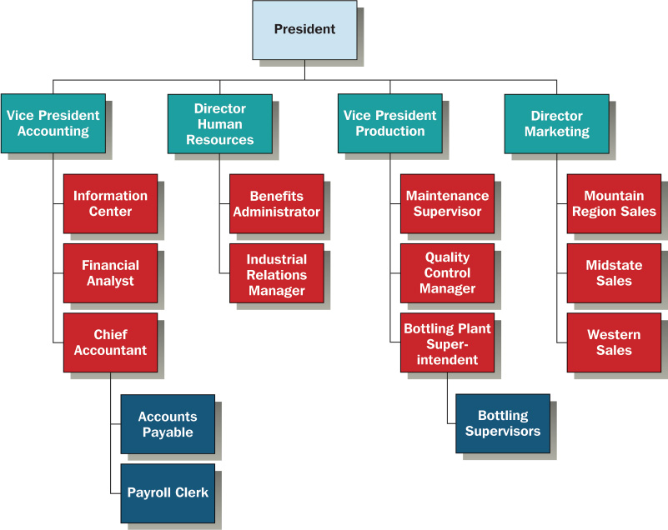
Organizing Chart
0

Slide 9
Span of Management
0
The number of employees reporting to a supervisor is span of management
Factors associated with less supervisor involvement and larger span of control
Work is stable and routine
Subordinates perform similar work
Subordinates in single location
Highly trained and need little direction
Rules and procedures are defined
Support systems and personnel are available to manager
Little supervision is required
Managers’ personal preference favor a large span

Slide 10
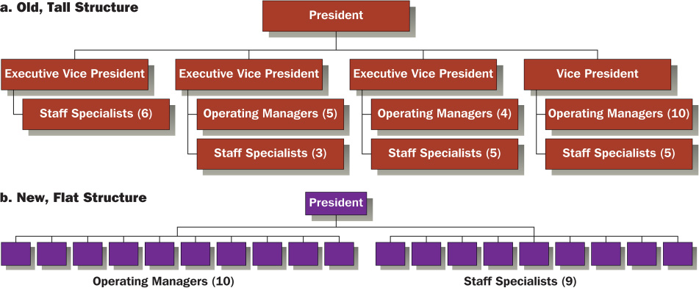
Reorganization to Increase Span of Management
0

Slide 11
Centralization and Decentralization
0
Centralization means that
decision authority
is located near the
top of the organization
Decentralization means
decision authority is
pushed downward to lower
organizational levels
Change and uncertainty are usually associated with decentralization
The amount of centralization or decentralization should fit the firm’s strategy
During crisis, such as risk of company failure, authority may be centralized

Slide 12
Departmentalization
0
Basis for grouping positions and functions into departments
Choices regarding chain of command
Three traditional approaches:
Vertical Functional
Divisional
Matrix
Recent more Innovative approaches:
Teams
Virtual Networks

Slide 13
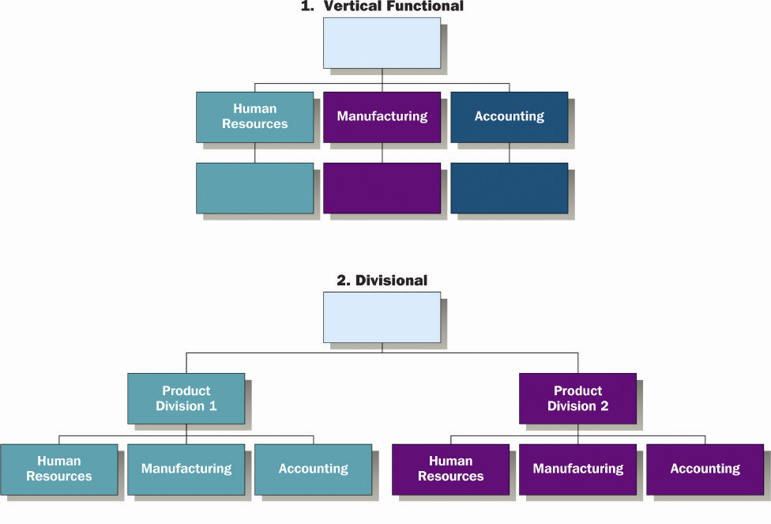
Approaches to Structural Design
0

Slide 14
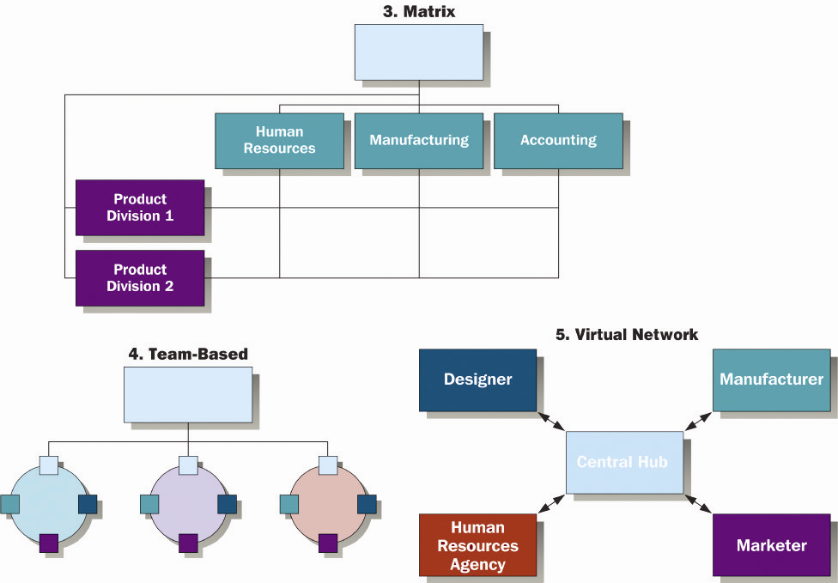
Approaches to Structural Design
0

Slide 15
Vertical Functional Approach
0
Grouping into departments based on skills, expertise, work activities and resource use
Departmentalized by organizational resources
Accounting
Human resources
Engineering
Manufacturing

Slide 16
Divisional Approach
0
Departments are grouped based on outputs
Product structure, program structure, self-contained unit structure
Many large corporations have multiple divisions for different business lines
Organizations may assign division responsibility by geographic region, customer group, or product group.

Slide 17
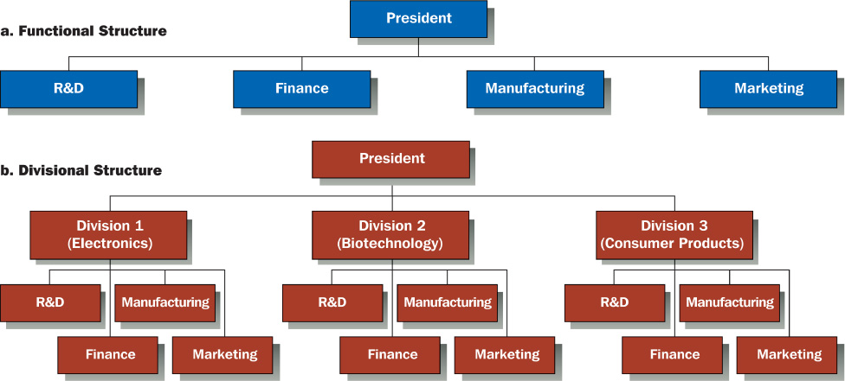
Functional Versus Divisional Approach
0

Slide 18
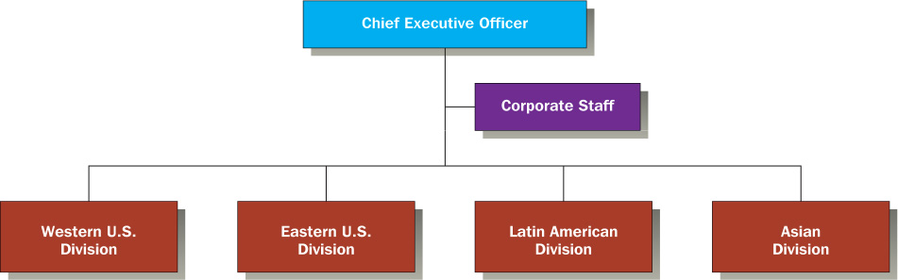
Geographic-Based Global Organization Structure
0

Slide 19
Matrix Approach
0
Combines aspects of both functional and divisional structures simultaneously
Improves coordination and information sharing
A key challenge is the dual lines of authority
Employees report to two supervisors
Violates Scalar Chain

Slide 20
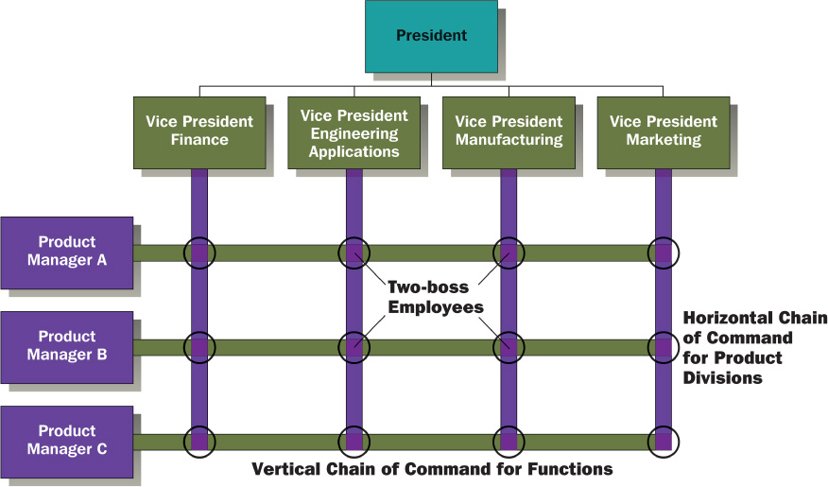
Dual-Authority Structure in a Matrix Organization
0

Slide 21
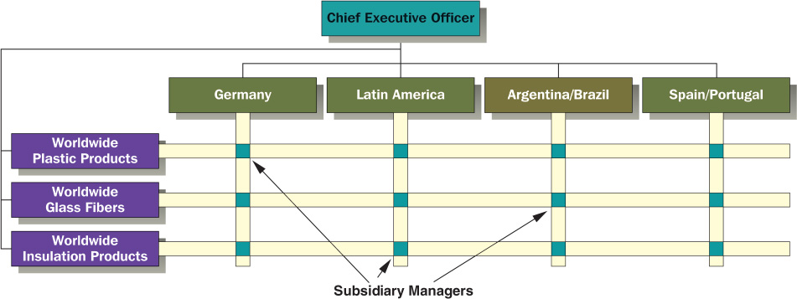
Global Matrix Structure
0

Slide 22
Team Approach
0
Teamwork is a growing trend
Teams allow organizations to delegate authority
Become flexible and competitive in global environment
Organizations may use cross-functional and/or permanent team strategies

Slide 23
The Virtual Network Approach
0
Extending the boundaries of collaboration beyond the organization
Subcontracting functions to other companies
Coordinate activities
Interconnected groups of companies
partnerships and collaborations

Slide 24
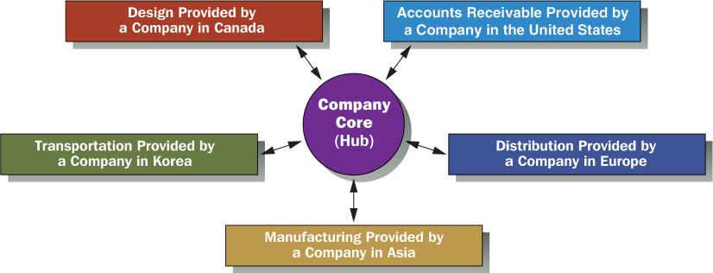
Network Approach to Departmentalization
0

Slide 25
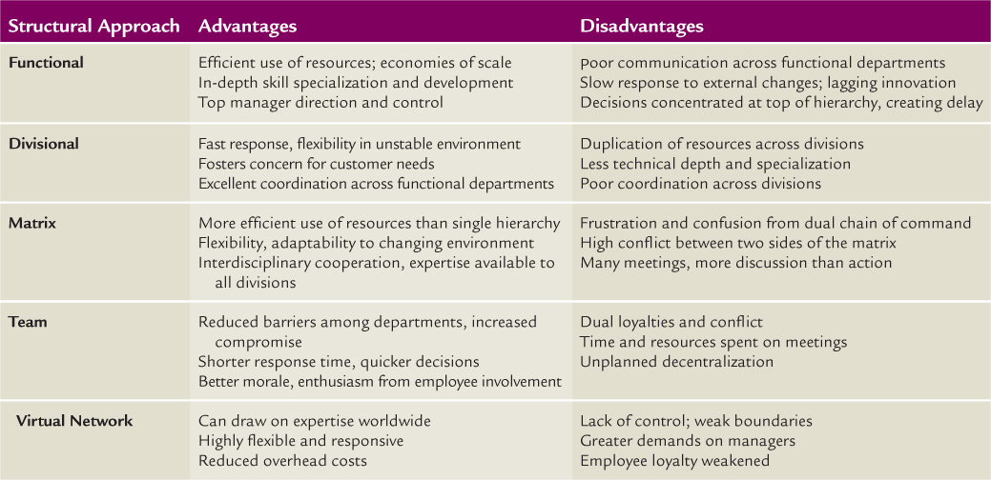
Structural Advantages and Disadvantages
0

Slide 26
The Need for Coordination
0
Organizations grow and evolve
Organizations need systems to process information and enable communication
Coordination is the quality of collaboration across departments
Coordination is required, regardless of the structure

Slide 27
Task Forces, Teams, and Project Management
0
Project Managers are
responsible for
coordinating
the activities of
several departments on
a full-time basis for
the completion
of a specific project
Task Force
A temporary team or
committee formed to
solve a specific
short-term
problem

Slide 28
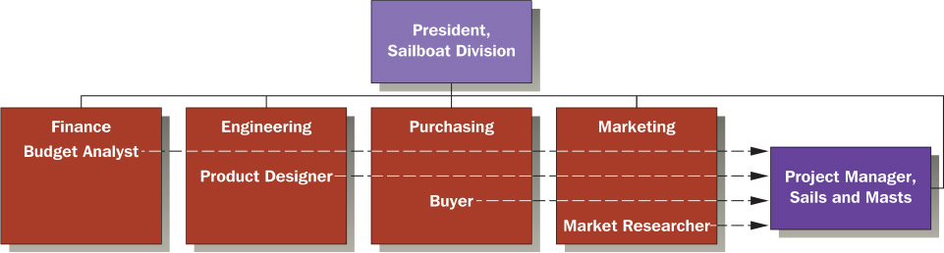
Examples of Project Manager Relationships
0

Slide 29
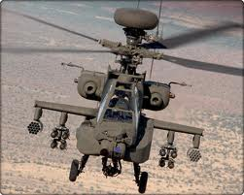
Reengineering/ Restructuring
0
Reengineering or business process reengineering – 70% fail
Radical redesign of business processes to achieve dramatic improvements - Value
Cost
Quality
Service
Speed
Boeing Mesa Plant

Slide 30
Reengineering Efforts
Why do so many efforts fail?
What should be done?
They wait too long to make a change.
Most companies can’t financially withstand a radical restructuring.
Boeing Mesa was a smaller division of a much larger organization.
Commitment to constant, small incremental changes.
Structure designed for change.
Constant observance for internal and external forces for change.
Careful analysis of change options.
Implement with employee involvement.
Reinforce the change.

Slide 31
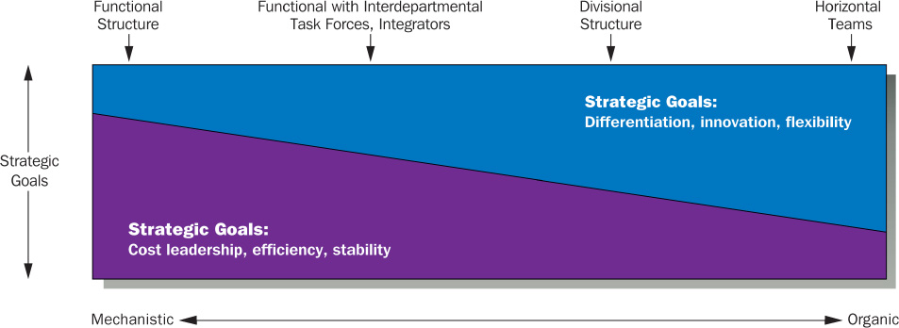
Structure Follows Strategy
0
The right structure is designed to fit the organization’s strategy

